Slide 1
STATISTICS
Statistics - Analysis of Variance

Slide 2
Analysis of Variance
Analysis of Variance also termed as ANOVA. It is procedure followed by statisticans to check the potential difference between scale-level dependent variable by a nominal-level variable having two or more categories. It was developed by Ronald Fisher in 1918 and it extends t-test and z-test which compares only nominal level variable to have just two categories

Slide 3
Types of ANOVA
One-way ANOVA - One-way ANOVA have only one independent variable and refers to numbers in this variable. For example, to assess differences in IQ by country, you can have 1, 2, and more countries data to compare.

Slide 4
Two-way ANOVA - Two way ANOVA uses two independent variables. For example, to access differences in IQ by country (variable 1) and gender(variable 2). Here you can examine the interaction between two independent variables. Such Interactions may indicate that differences in IQ is not uniform across a independent variable. For examples females may have higher IQ score over males and have very high score over males in Europe than in America.
Two-way ANOVAs are also termed as factorial ANOVA and can be balanced as well as unbalanced. Balanced refers to having same number of participants in each group where as unbalanced refers to having different number of participants in each group. Following special kind of ANOVAs can be used to handle unbalanced groups.
Hierarchical approach(Type 1) -If data was not intentionaly unbalanced and has some type of hierarchy between the factors.
Classical experimental approach(Type 2) - If data was not intentionaly unbalanced and has no hierarchy between the factors.
Full Regression approach(Type 3) - If data was intentionaly unbalanced because of population.

Slide 5
N-way or Multivariate ANOVA - N-way ANOVA have multiple independent variables. For example, to assess differences in IQ by country, gender, age etc. simultaneously, N-way ANOVA is to be deployed.

Slide 6
ANOVA Test Procedure
Setup null and alternative hypothesis where null hypothesis states that there is no significant difference among the groups. And alternative hypothesis assumes that there is a significant difference among the groups.
Calculate F-ratio and probability of F.
Compare p-value of the F-ratio with the established alpha or significance level.
If p-value of F is less than 0.5 then reject the null hypothesis.
If null hypothesis is rejected, conclude that mean of groups are not equal.

Slide 7

Terminologies in ANOVA Test
1. Means(Grand and Sample)
As we know, a mean is defined as an arithmetic average of a given range of values. In the ANOVA test, there are two types of mean that are calculated: Grand and Sample Mean.
A sample mean (μ_{n}) represents the average value for a group while the grand mean (μ) represents the average value of sample means of different groups or mean of all the observations combined

Slide 8

2. F-Statistic
The statistic which measures the extent of difference between the means of different samples or how significantly the means differ is called the F-statistic or F-Ratio. It gives us a ratio of the effect we are measuring (in the numerator) and the variation associated with the effect (in the denominator).
Since we use variances to explain both the measure of the effect and the measure of the error, F is more of a ratio of variances. The value of F can never be negative.
When the value of F exceeds 1 it means that the variance due to the effect is larger than the variance associated with sampling error; we can represent it as:
When F>1, variation due to the effect > variation due to error
If F<1, it means variation due to effect < variation due to error
When F = 1 it means variation due to effect = variation due to error. This situation is not so favorable.

Slide 9
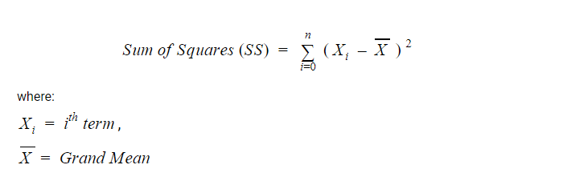
3. Sums of Squares
In statistics, the sum of squares is defined as a statistical technique that is used in regression analysis to determine the dispersion of data points. In the ANOVA test, it is used while computing the value of F.
As the sum of squares tells you about the deviation from the mean, it is also known as variation.
The formula given to calculate the sum of squares is:
While calculating the value of F, we need to find SSTotal that is equal to the sum of SS_{Effect} and SS_{Error}.
SS_{Total} = SS_{Effect} + SS_{Error}

Slide 10
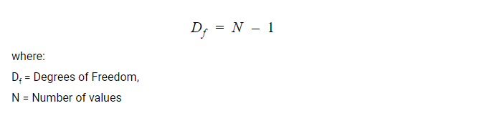
4. Degrees of Freedom (D_{f})
Degrees of Freedom refers to the maximum numbers of logically independent values that have the freedom to vary in a data set.

Slide 11

5. Mean Squared Error (MSE)
The Mean Squared Error tells us about the average error in a data set. To find the mean squared error, we just divide the sum of squares by the degrees of freedom.

Slide 12
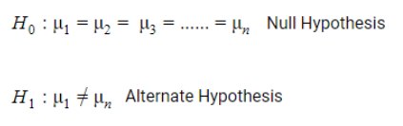
6. Hypothesis (Alternate and Null)
Hypothesis, in general terms, is an educated guess about something around us. When we are given a set of data and are required to predict, we use some calculations and make a guess. This is all a hypothesis.
In the ANOVA test, we use Null Hypothesis (H₀) and Alternate Hypothesis (H₁). The Null Hypothesis in ANOVA is valid when the sample means are equal or have no significant difference.
The Alternate Hypothesis is valid when at least one of the sample means is different from the other.

Slide 13
7. Group Variability (Within-group and Between-group)
To understand group variability, we should know about groups first. In the ANOVA test, a group is the set of samples within the independent variable.
There are variations among the individual groups as well as within the group. This gives rise to the two terms: Within-group variability and Between-group variability.
When there is a big variation in the sample distributions of the individual groups, it is called between-group variability.
On the other hand, when there are variations in the sample distribution within an individual group, it is called Within-group variability.

Slide 14
ANOVA TEST EXAMPLE
Suppose we have four independent populations that satisfy the conditions for single factor ANOVA. We wish to test the null hypothesis H₀: μ₁ = μ₂ = μ₃ = μ₄. For purposes of this example, we will use a sample of size three from each of the populations being studied. The data from our samples is:
Sample from population #1: 12, 9, 12. This has a sample mean of 11.
Sample from population #2: 7, 10, 13. This has a sample mean of 10.
Sample from population #3: 5, 8, 11. This has a sample mean of 8.
Sample from population #4: 5, 8, 8. This has a sample mean of 7.

Slide 15
Calculate the sample means for each of our samples as well as the mean for all of the sample data.
Calculate the sum of squares of error. Here within each sample, we square the deviation of each data value from the sample mean. The sum of all of the squared deviations is the sum of squares of error, abbreviated SSE.
Calculate the sum of squares of treatment. We square the deviation of each sample mean from the overall mean. The sum of all of these squared deviations is multiplied by one less than the number of samples we have. This number is the sum of squares of treatment, abbreviated SST.
Calculate the degrees of freedom. The overall number of degrees of freedom is one less than the total number of data points in our sample, or n - 1. The number of degrees of freedom of treatment is one less than the number of samples used, or m - 1. The number of degrees of freedom of error is the total number of data points, minus the number of samples, or n - m.
Calculate the mean square of error. This is denoted MSE = SSE/(n - m).
Calculate the mean square of treatment. This is denoted MST = SST/m - `1.
Calculate the F statistic. This is the ratio of the two mean squares that we calculated. So F = MST/MSE.

Slide 16
Data and Sample Means
Suppose we have four independent populations that satisfy the conditions for single factor ANOVA. We wish to test the null hypothesis H₀: μ₁ = μ₂ = μ₃ = μ₄. For purposes of this example, we will use a sample of size three from each of the populations being studied. The data from our samples is:
Sample from population #1: 12, 9, 12. This has a sample mean of 11.
Sample from population #2: 7, 10, 13. This has a sample mean of 10.
Sample from population #3: 5, 8, 11. This has a sample mean of 8.
Sample from population #4: 5, 8, 8. This has a sample mean of 7.
The mean of all of the data is 9.

Slide 17
Sum of Squares of Error
We now calculate the sum of the squared deviations from each sample mean. This is called the sum of squares of error.
For the sample from population #1: (12 – 11)² + (9– 11)² +(12 – 11)² = 6
For the sample from population #2: (7 – 10)² + (10– 10)² +(13 – 10)² = 18
For the sample from population #3: (5 – 8)² + (8 – 8)² +(11 – 8)² = 18
For the sample from population #4: (5 – 7)² + (8 – 7)² +(8 – 7)² = 6.
We then add all of these sum of squared deviations and obtain 6 + 18 + 18 + 6 = 48.

Slide 18
Sum of Squares of Treatment
Now we calculate the sum of squares of treatment. Here we look at the squared deviations of each sample mean from the overall mean, and multiply this number by one less than the number of populations:
3[(11 – 9)² + (10 – 9)² +(8 – 9)² + (7 – 9)²] = 3[4 + 1 + 1 + 4] = 30.
Degrees of Freedom
Before proceeding to the next step, we need the degrees of freedom. There are 12 data values and four samples. Thus the number of degrees of freedom of treatment is 4 – 1 = 3. The number of degrees of freedom of error is 12 – 4 = 8.

Slide 19
Mean Squares
We now divide our sum of squares by the appropriate number of degrees of freedom in order to obtain the mean squares.
The mean square for treatment is 30 / 3 = 10.
The mean square for error is 48 / 8 = 6.
The F-statistic
The final step of this is to divide the mean square for treatment by the mean square for error. This is the F-statistic from the data. Thus for our example F = 10/6 = 5/3 = 1.667.

Slide 20
Statistics - Arithmetic Mean
Arithmetic Mean in the most common and easily understood measure of central tendency.
We can define mean as the value obtained by dividing the sum of measurements
with the number of measurements contained in the data set and is denoted by the symbol x¯.
We're going to discuss methods to compute the Arithmetic Mean for three types of series:
Individual Data Series
Discrete Data Series
Continuous Data Series

Slide 21
Data Series
Individual Data Series
When data is given on individual basis. Following is an example of individual series:
Items | 5 | 10 | 20 | 30 | 40 | 50 | 60 | 70
Discrete Data Series
When data is given alongwith their frequencies. Following is an example of discrete series:
Items | 5 | 10 | 20 | 30 | 40 | 50 | 60 | 70
Frequency | 2 | 5 | 1 | 3 | 12 | 0 | 5 | 7
Items | 5 | 10 | 20 | 30 | 40 | 50 | 60 | 70

Slide 22
Continuous Data Series
When data is given based on ranges alongwith their frequencies. Following is an example of continous series:
Items | 0-5 | 5-10 | 10-20 | 20-30 | 30-40
Frequency | 2 | 5 | 1 | 3 | 12

Slide 23
Statistics - Arithmetic Median
Arithmetic Median is a positional average and refers to the middle value in a distribution.
It divides the series into two halves by first arranging the items in ascending or descending order of magnitude and then
locating the middle value and is denoted by the symbol X~X~ or M.
We're going to discuss methods to compute the Arithmetic Median for three types of series:
Individual Data Series
Discrete Data Series
Continuous Data Series

Slide 24
Statistics - Arithmetic Mode
Arithmetic Mode refers to the most frequently occurring value in the data set.
In other words,
modal value has the highest frequency associated with it.
It is denoted by the symbol MoMo or Mode.
We're going to discuss methods to compute the Arithmetic Mode for
three types of series:
Individual Data Series
Discrete Data Series
Continuous Data Series

Slide 25
Statistics - Arithmetic Range
The Arithmetic Range of a set of data is the difference between the highest and
lowest values in the set.
Arithmetic Range is defined and given by the following function:
Formula
Range=L−SRange=L−S
Where −
LL = Largest item
SS = Smallest item
This is an absolute measure. The relative measure called as coefficient of range
is given by
Coefficient of Range=L−S/L+S

Slide 26
Problem Statement:
Cheryl took 7 math tests in one marking period. What is the range of her test scores and coeff.of range?
89 | 73 | 84 | 91 | 87 | 77 | 94

Slide 27
73 | 77 | 84 | 87 | 89 | 91 | 94
Solution:
Ordering the test scores from least to greatest, we get:
Range = Largest − Smallest =94−73=21Range = Largest − Smallest =94−73=21
Largest + Smallest =94+73=167Coefficient of Range=L−SL+S=21167=0.1257Largest + Smallest =94+73=167Coefficient of Range=L−S/L+S=21167=0.1257
The Range of these test scores is 21 points and coeff. of range is 0.1257 points.

Slide 28
Statistics - Best Point Estimation
Point estimation involves the use of sample data to calculate a
single value (known as a statistic) which is to serve as a "best guess" or "best estimate" of an unknown (fixed or random) population
parameter. More formally, it is the application of a point estimator to the data.

Slide 29
Formula
MLE=STMLE=S/T
Laplace=S+1/T+2
Jeffrey=S+0.5/T+1
Wilson=S+z2/2//T+z2
Where −
MLEMLE = Maximum Likelihood Estimation.
SS = Number of Success .
TT = Number of trials.
zz = Z-Critical Value.

Slide 30
Problem Statement:
If a coin is tossed 4 times out of nine trials in 99% confidence interval level, then what is the best point of success of that coin?

Slide 31
Solution:
Success(S) = 4 Trials (T) = 9 Confidence Interval Level (P) = 99% = 0.99. In order to compute best point estimation, let compute all the values:
Step 1
MLE=S/T=4/9,=0.4444MLE=ST=49,=0.4444
Step 2
Laplace=S+1/T+2=4+1/9+2,=5/11,=0.4545Laplace=S+1T+2=4+19+2,=511,=0.4545
Step 3
Jeffrey=S+0.5/T+1=4+0.59+1,=4.5/10,=0.45Jeffrey=S+0.5T+1=4+0.59+1,=4.510,=0.45
Step 4
Discover Z-Critical Value from Z table. Z-Critical Value (z) = for 99% level = 2.5758
Step 5
Wilson=S+z2/2//T+z2=4+2.57582229+2.575822,=0.468Wilson=S+z22T+z2=4+2.57582229+2.575822,=0.468
Result
Accordingly the Best Point Estimation is 0.468 as MLE ≤ 0.5

Slide 32
beta distribution
In probability theory and statistics, the beta distribution is a family of continuous probability distributions defined on the interval [0, 1] parameterized by two positive shape parameters, denoted by α and β, that appear as exponents of the random variable and control the shape of the distribution. The generalization to multiple variables is called a Dirichlet distribution.
The beta distribution has been applied to model the behavior of random variables limited to intervals of finite length in a wide variety of disciplines.

Slide 33
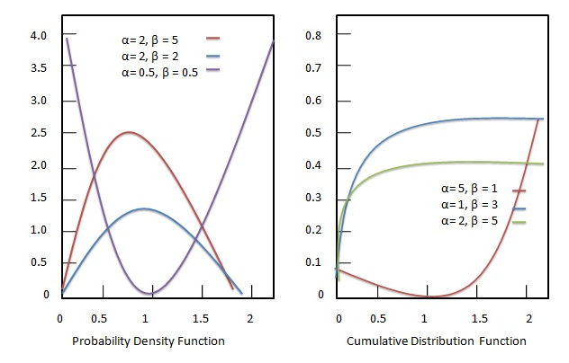

Slide 34
What is Probability?
Probability is a measure or estimation of how likely it is that something will happen or that a statement is true

Slide 35
discrete probability distribution
A discrete probability distribution describes the probability of the occurrence of each value of a discrete random variable. A discrete random variable is a random variable that has countable values. The variable is said to be random if the sum of the probabilities is one.
For example, if a coin is tossed three times, then the number of heads obtained can be 0, 1, 2 or 3. In other words, the number of heads can only take 4 values: 0, 1, 2, and 3 and so the variable is discrete. Note that getting either a heads or tail, even 0 times, has a value in a discrete probability distribution.

Slide 36

Statistics - Binomial Distribution
Bionominal appropriation is a discrete likelihood conveyance. This distribution was discovered by a Swiss Mathematician James Bernoulli. It is used in such situation where an experiment results in two possibilities - success and failure. Binomial distribution is a discrete probability distribution which expresses the probability of one set of two alternatives-successes (p) and failure (q). Binomial distribution is defined and given by the following probability function:

Slide 37
Where −
pp = Probability of success.
qq = Probability of failure = 1−p1−p.
nn = Number of trials.
P(X−x)P(X−x) = Probability of x successes in n trials.

Slide 38
A Bernoulli trial is assumed to meet each of these criteria :
There must be only 2 possible outcomes.
Each outcome has a fixed probability of occurring. A success has the probability of p, and a failure has the probability of 1 – p.
Each trial is completely independent of all others.

Slide 39
Problem Statement:
Eight coins are tossed at the same time. Discover the likelihood of getting no less than 6 heads.

Slide 40
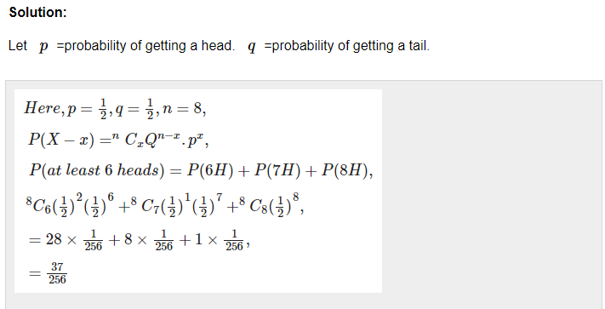

Slide 41
Problem Statement:
Eight coins are tossed at the same time. Discover the likelihood of getting at most 6 heads.

Slide 42
Python – Binomial Distribution
Using Python to obtain the distribution : Now, we will use Python to analyse the distribution(using SciPy) and plot the graph(using Matplotlib). Modules required :
SciPy: SciPy is an Open Source Python library, used in mathematics, engineering, scientific and technical computing.
Installation :
pip install scipy
Matplotlib: Matplotlib is a comprehensive Python library for plotting static and interactive graphs and visualisations.
Installation :
pip install matplotlib
The scipy.stats module contains various functions for statistical calculations and tests.
The stats() function of the scipy.stats.binom module can be used to calculate a binomial distribution
using the values of n and p.
Syntax : scipy.stats.binom.stats(n, p)

Slide 43
It returns a tuple containing the mean and variance of the distribution in that order.
scipy.stats.binom.pmf() function is used to obtain the probability
mass function for a certain value of r, n and p. We can obtain the distribution by passing
all possible values of r(0 to n).
Syntax : scipy.stats.binom.pmf(r, n, p)

Slide 44
Approach
from scipy.stats import binom
# setting the values
# of n and p
n = 6
p = 0.6
# defining the list of r values
r_values = list(range(n + 1))
# obtaining the mean and variance
mean, var = binom.stats(n, p)
# list of pmf values
dist = [binom.pmf(r, n, p) for r in r_values ]
# printing the table
print("r\tp(r)")
for i in range(n + 1):
print(str(r_values[i]) + "\t" + str(dist[i]))
# printing mean and variance
print("mean = "+str(mean))
print("variance = "+str(var))

Slide 45
from scipy.stats import binom
import matplotlib.pyplot as plt
# setting the values
# of n and p
n = 6
p = 0.6
# defining list of r values
r_values = list(range(n + 1))
# list of pmf values
dist = [binom.pmf(r, n, p) for r in r_values ]
# plotting the graph
plt.bar(r_values, dist)
plt.show()

Slide 46
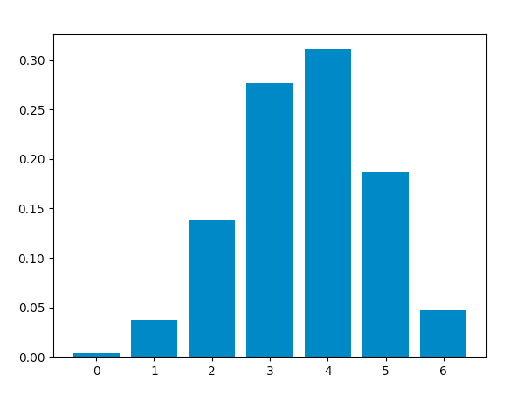
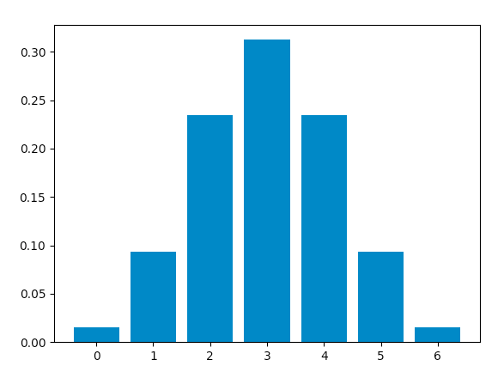
When success and failure are equally likely, the binomial distribution is a normal distribution. Hence, changing the value of p to 0.5, we obtain this graph, which is identical to a normal distribution plot

Slide 47
What Is a Poisson Distribution?
In statistics, a Poisson distribution is a probability distribution that can be used to show how many times an event is likely to occur within a specified period of time﻿. In other words, it is a count distribution. Poisson distributions are often used to understand independent events that occur at a constant rate within a given interval of time. It was named after French mathematician Siméon Denis Poisson.
The Poisson distribution is a discrete function, meaning that the variable can only take specific values in a (potentially infinite) list. Put differently, the variable cannot take all values in any continuous range. For the Poisson distribution (a discrete distribution), the variable can only take the values 0, 1, 2, 3, etc., with no fractions or decimals.

Slide 48
A Poisson distribution can be used to estimate how likely it is that something will happen "X" number of times. For example, if the average number of people who rent movies on a Friday night at a single video store location is 400, a Poisson distribution can answer such questions as, "What is the probability that more than 600 people will rent movies?" Therefore, the application of the Poisson distribution enables managers to introduce optimal scheduling systems that would not work with, say, a normal distribution.

Slide 49
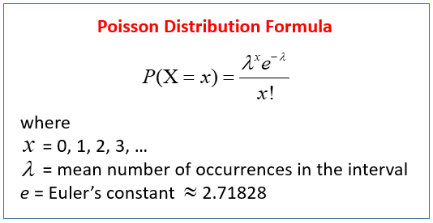

Slide 50
My computer crashes on average once every 4 months;
a) What is the probability that it will not crash in a period of 4 months?
b) What is the probability that it will crash once in a period of 4 months?
c) What is the probability that it will crash twice in a period of 4 months?
d) What is the probability that it will crash three times in a period of 4 months?

Slide 51
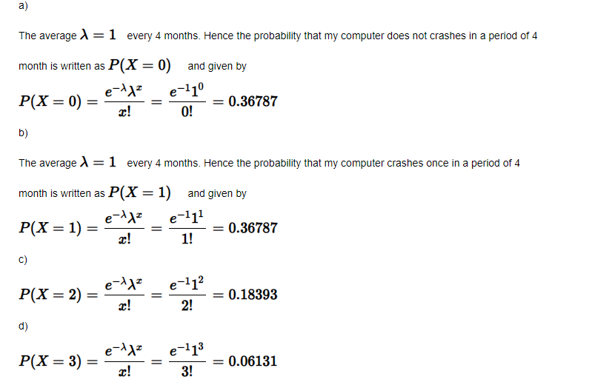

Slide 52
A customer help center receives on average 3.5 calls every hour.
a) What is the probability that it will receive at most 4 calls every hour?
b) What is the probability that it will receive at least 5 calls every hour?

Slide 53
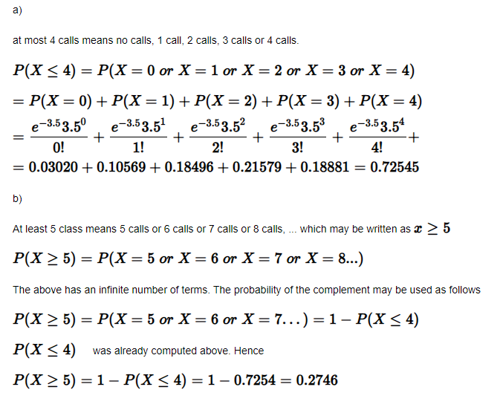

Slide 54
A person receives on average 3 e-mails per hour.
a) What is the probability that he will receive 5 e-mails over a period two hours?
a) What is the probability that he will receive more than 2 e-mails over a period two hours?

Slide 55
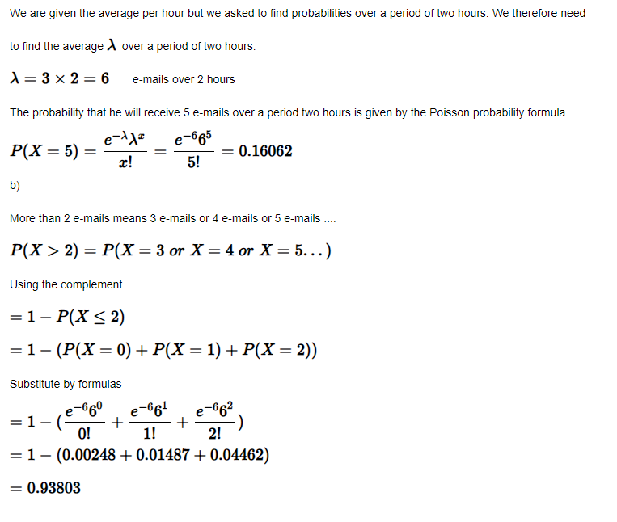

Slide 56
What Is the Central Limit Theorem (CLT)?
In the study of probability theory, the central limit theorem (CLT) states that the distribution of sample approximates a
normal distribution (also known as a “bell curve”) as the sample size becomes larger, assuming that all samples are identical in size, and regardless of the population distribution shape.

Slide 57
KEY TAKEAWAYS
The central limit theorem (CLT) states that the distribution of sample means approximates a normal distribution as the sample size gets larger.
Sample sizes equal to or greater than 30 are considered sufficient for the CLT to hold.
A key aspect of CLT is that the average of the sample means and standard deviations will equal the population mean and standard deviation.
A sufficiently large sample size can predict the characteristics of a population accurately.

Slide 58
Understanding the Central Limit Theorem (CLT)
According to the central limit theorem, the mean of a sample of data will be closer to the mean of the overall population in question, as the sample size increases, notwithstanding the actual distribution of the data. In other words, the data is accurate whether the distribution is normal or aberrant.

Slide 59
As a general rule, sample sizes equal to or greater than 30 are deemed sufficient for the CLT to hold, meaning that the distribution of the sample means is fairly normally distributed. Therefore, the more samples one takes, the more the graphed results take the shape of a normal distribution.
Central Limit Theorem exhibits a phenomenon where the average of the sample means and standard deviations equal the population mean and standard deviation, which is extremely useful in accurately predicting the characteristics of populations.

Slide 60
Central Limit Theorem
Normal distribution is used to represent random variables with unknown distributions. Thus, it is widely used in many fields including natural and social sciences. The reason to justify why it can used to represent random variables with unknown distributions is the central limit theorem (CLT).
According to the CLT, as we take more samples from a distribution, the sample averages will tend towards a normal distribution regardless of the population distribution.

Slide 61
examples
Consider a case that we need to learn the distribution of the heights of all 20-year-old people in a country. It is almost impossible and, of course not practical, to collect this data. So, we take samples of 20-year-old people across the country and calculate the average height of the people in samples. According to the CLT, as we take more samples from the population, sampling distribution will get close to a normal distribution.
Why is it so important to have a normal distribution? Normal distribution is described in terms of mean and standard deviation which can easily be calculated. And, if we know the mean and standard deviation of a normal distribution, we can compute pretty much everything about it.

Slide 62
The Central Limit Theorem is the sampling distribution of the sampling means approaches a normal distribution as the sample size gets larger, no matter what the shape of the data distribution. An essential component of the Central Limit Theorem is the average of sample means will be the population mean.
Similarly, if you find the average of all of the standard deviations in your sample, you will find the actual standard deviation for your population.
Mean of sample is same as the mean of the population.
The standard deviation of the sample is equal to the standard deviation of the population divided by the square root of the sample size.

Slide 63
Central limit theorem is applicable for a sufficiently large sample sizes (n ≥ 30). The formula for central limit theorem can be stated as follows:
μX= μ
and
σx¯¯¯=σ/√n
Where, μ = Population mean σ = Population standard deviation μx¯¯¯ = Sample mean σx¯¯¯ = Sample standard deviation n = Sample size

Slide 64
Question: The record of weights of the male population follows the normal distribution. Its mean and standard deviations are 70 kg and 15 kg respectively. If a researcher considers the records of 50 males, then what would be the mean and standard deviation of the chosen sample?

Slide 65
Mean of the population μ = 70 kg Standard deviation of the population = 15 kg sample size n = 50 Mean of the sample is given by: μx¯¯¯ = 70 kg Standard deviation of the sample is given by: σx¯¯¯ = σ/√N σx¯¯¯ = 15/√50 σx¯¯¯ = 2.122 = 2.1 kg (approx)

Slide 66
Chi-square distribution
In probability theory and statistics, the chi-square distribution (also chi-squared or χ2-distribution) with k degrees of freedom is the distribution of a sum of the squares of k independent standard normal random variables. The chi-square distribution is a special case of the gamma distribution and is one of the most widely used probability distributions in inferential statistics, notably in hypothesis testing and in construction of confidence intervals.This distribution is sometimes called the central chi-square distribution, a special case of the more general noncentral chi-square distribution.

Slide 67
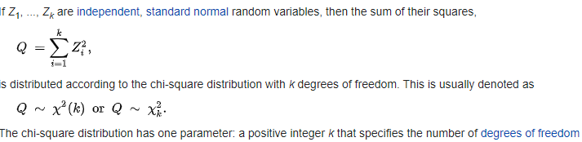

Slide 68

Finding Chi Square
Chi square is a calculation used to determine how closely the observed data fit the expected data. In the following chi square calculation formula, X represents chi, while o and e represent the observed and expected values, respectively:

Slide 69
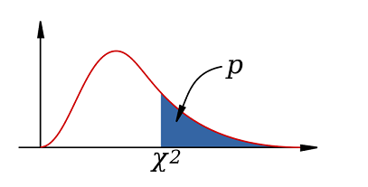
Chi square distribution is a type of cumulative probability distribution. Probability distributions provide the probability of every possible value that may occur. Distributions that are cumulative give the probability of a random variable being less than or equal to a particular value. Since the sum of the probabilities of every possible value must equal one, the total area under the curve is equal to one.
To find the probability of a particular value, we find the area under the curve before the value. The area that's after the value is called the p-value, which is important for statistical tests that use chi square. In this figure, X^2 represents chi square and p represents the p-value:

Slide 70
When to Use a Chi-Square Test
1. The Chi-Square Goodness of Fit Test – Used to determine whether or not a categorical variable follows a hypothesized distribution.
2. The Chi-Square Test of Independence – Used to determine whether or not there is a significant association between two categorical variables.
Note that both of these tests are only appropriate to use when you’re working with categorical variables. These are variables that take on names or labels and can fit into categories. Examples include:
Eye color (e.g. “blue”, “green”, “brown”)
Gender (e.g. “male”, “female”)
Marital status (e.g. “married”, “single”, “divorced”)
This tutorial explains when to use each test along with several examples of each.
The Chi-Square Goodness of Fit Test
You should use the Chi-Square Goodness of Fit Test whenever you would like to know if some categorical variable follows some hypothesized distribution.

Slide 71
Python – Pearson’s Chi-Square Test
The Pearson’s Chi-Square statistical hypothesis is a test for independence between categorical variables. In this article, we will perform the test using a mathematical approach and then using Python’s SciPy module. First, let us see the mathematical approach :
The Contingency Table : A Contingency table (also called crosstab) is used in statistics to summarise the relationship between several categorical variables. Here, we take a table that shows the number of men and women buying different types of pets.

Slide 72
men | 207 | 282 | 241 | 730
women | 234 | 242 | 232 | 708
total | 441 | 524 | 473 | 1438

Slide 73
he aim of the test is to conclude whether the two variables( gender and choice of pet ) are related to each other.
Null hypothesis: We start by defining the null hypothesis (H0) which states that there is no relation between the variables. An alternate hypothesis would state that there is a significant relation between the two.

Slide 74
We can verify the hypothesis by these methods:
Using p-value:
We define a significance factor to determine whether the relation between the variables is of considerable significance. Generally a significance factor or alpha value of 0.05 is chosen. This alpha value denotes the probability of erroneously rejecting H0 when it is true. A lower alpha value is chosen in cases where we expect more precision. If the p-value for the test comes out to be strictly greater than the alpha value, then H0 holds true.
Using chi-square value:
If our calculated value of chi-square is less or equal to the tabular(also called critical) value of chi-square, then H0 holds true.

Slide 75


Slide 76
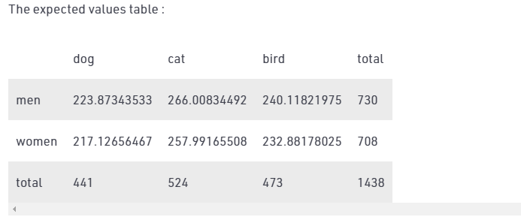

Slide 77
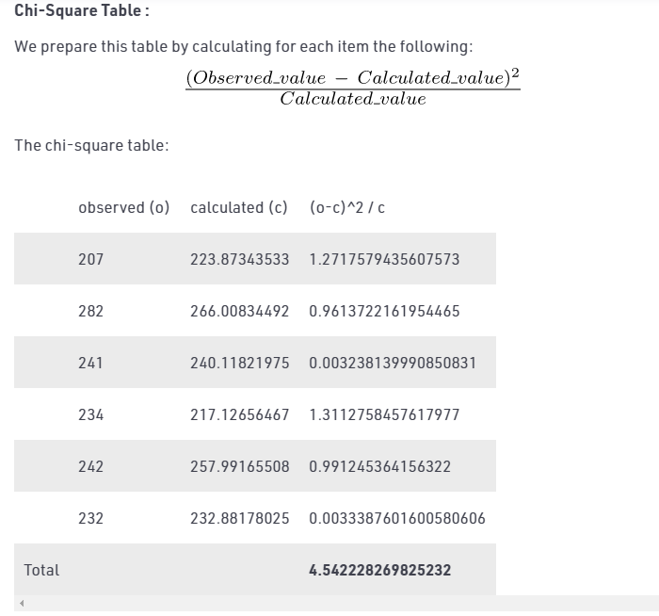

Slide 78
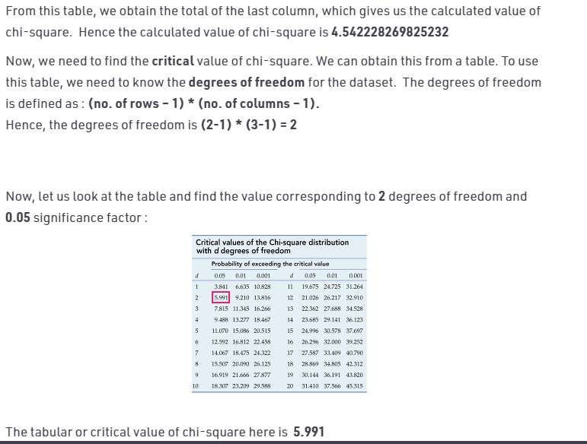

Slide 79
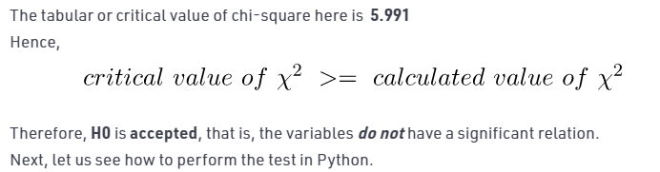

Slide 80
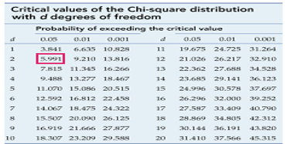
men | 245 | 292 | 411 | 948
women | 334 | 342 | 202 | 878
total | 579 | 634 | 613 | 1826

Slide 81
Compare the p-value of the test statistic X² to a chosen alpha level
The second approach we can use to determine if our results are statistically significant is to find the p-value for the test statistic X² . In order to find this p-value, we can’t use the Chi-square distribution table because it only provides us with critical values, not p-values.
A small p-value (typically ≤ 0.05) indicates strong evidence against the null hypothesis, so you reject the null hypothesis. A large p-value (> 0.05) indicates weak evidence against the null hypothesis, so you fail to reject the null hypothesis.

Slide 82
cluster sampling
In cluster sampling, researchers divide a population into smaller groups known as clusters. They then randomly select among these clusters to form a sample.
Cluster sampling is a method of probability sampling that is often used to study large populations, particularly those that are widely geographically dispersed. Researchers usually use pre-existing units such as schools or cities as their clusters.

Slide 83
How to cluster sample
The simplest form of cluster sampling is single-stage cluster sampling. It involves 4 key steps.
Research exampleYou are interested in the average reading level of all the seventh-graders in your city.
It would be very difficult to obtain a list of all seventh-graders and collect data from a random sample spread across the city. However, you can easily obtain a list of all schools and collect data from a subset of these. You thus decide to use the cluster sampling method.

Slide 84
Example: Multistage samplingInstead of collecting data from every seventh-grader in the selected schools, you narrow down your sample in two additional stages:
From each school, you randomly select a sample of seventh-grade classes.
From within those classes, you randomly select a sample of students.
The resulting sample is much smaller and therefore easier to collect data from.

Slide 85
Step 1: Define your population
As with other forms of sampling, you must first begin by clearly defining the population you wish to study.

Slide 86
This is the first step we have to perform for sampling in this we have to clearly select the targeted area from the population.
For understanding in easy language let’s take an example of integers, integers are the number which can be written without fractional form like all negative and positive numbers ( -1,-4,-8,3,5,2,0……etc ) so we take all the integers as our data and from this data we have to select our targeted area for performing the sampling. From these data of integers, we can target either all the positive numbers or all the negative.
Here we assume that our targeted area is all positive numbers means we take all positive numbers from integers data as our sample.

Slide 87
Step 2: Divide your sample into clusters
This is the most important part of the process. The quality of your clusters and how well they represent the larger population determines the validity of your results. Ideally, you would like for your clusters to meet the following criteria:

Slide 88
Step 3: Randomly select clusters to use as your sample
If each cluster is itself a mini-representation of the larger population, randomly selecting and sampling from the clusters allows you to imitate simple random sampling, which in turn supports the validity of your results.
Conversely, if the clusters are not representative, then random sampling will allow you to gather data on a diverse array of clusters, which should still provide you with an overview of the population as a whole.

Slide 89
After we select the sampling method we divide samples into clusters, it is an important part of performing cluster sampling we have to create a quality cluster as they produce better accuracy after sampling. we remind that clusters we are producing have the better impact it means they represent well to our population. Clusters have to be equally and similarly distributed as there is no repetition among them. Ideally, each cluster should be a mini-representation of the entire population

Slide 90
Step 4: Collect data from the sample
You then conduct your study and collect data from every unit in the selected clusters.

Slide 91
Step 4: Collect data.
In the last step after performing the above steps, we collect our desirable data from the sample.
We take an example of cluster sampling in which we take 1 to n natural numbers that will make clusters and from that cluster, we select the random individual clusters for sampling.

Slide 92
Multi-stage cluster sampling
In multi-stage clustering, rather than collect data from every single unit in the selected clusters, you randomly select individual units from within the cluster to use as your sample.
Example: Multistage samplingInstead of collecting data from every seventh-grader in the selected schools, you narrow down your sample in two additional stages:
From each school, you randomly select a sample of seventh-grade classes.
From within those classes, you randomly select a sample of students.
The resulting sample is much smaller and therefore easier to collect data from.

Slide 93
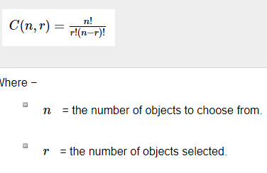
A combination is a selection of all or part of a set of objects, without regard to the order in which objects are selected. For example, suppose we have a set of three letters: A, B, and C. we might ask how many ways we can select 2 letters from that set.
Combination is defined and given by the following function:

Slide 94
How many different groups of 10 students can a teacher select from her classroom of 15 students?

Slide 95
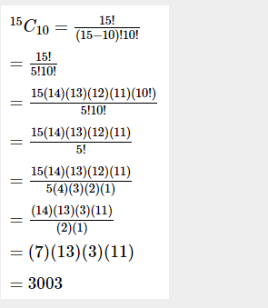
Step 1: Determine whether the question pertains to permutations or combinations. Since changing the order of the selected students would not create a new group, this is a combinations problem.
Step 2: Determine n and r
n = 15 since the teacher is choosing from 15 students.
r = 10 since the teacher is selecting 10 students.
Step 3: Apply the formula

Slide 96
How many different groups of 8 player select from her team of 18 players?

Slide 97
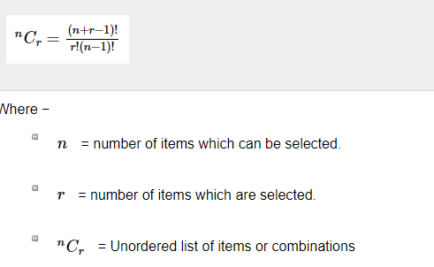
Combination with replacement
Each of several possible ways in which a set or number of things can be ordered or arranged is called permutation Combination with replacement in probability is selecting an object from an unordered list multiple times.

Slide 98
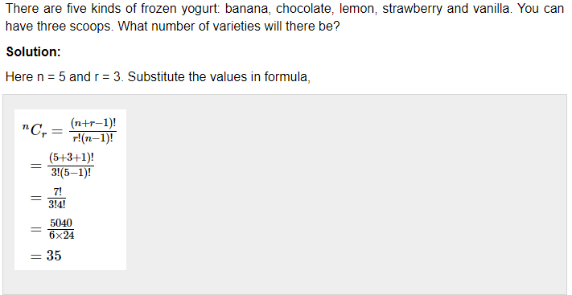

Slide 99
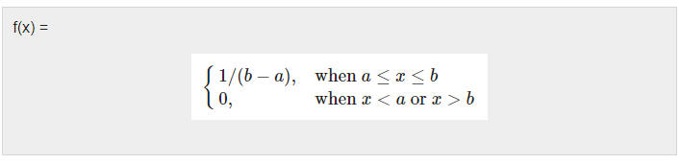
Continuous Uniform Distribution
The continuous uniform distribution is the probability distribution of random number selection from the continuous interval between a and b. Its density function is defined by the following. Here is a graph of the continuous uniform distribution with a = 1, b = 3

Slide 100
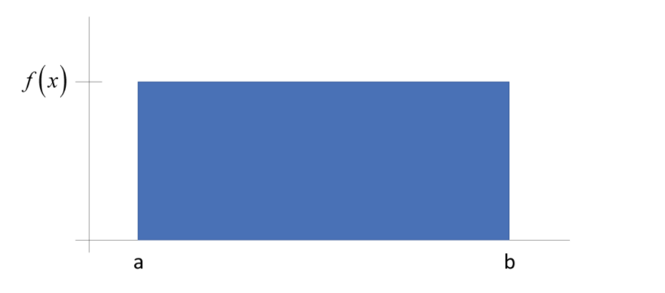

Slide 101
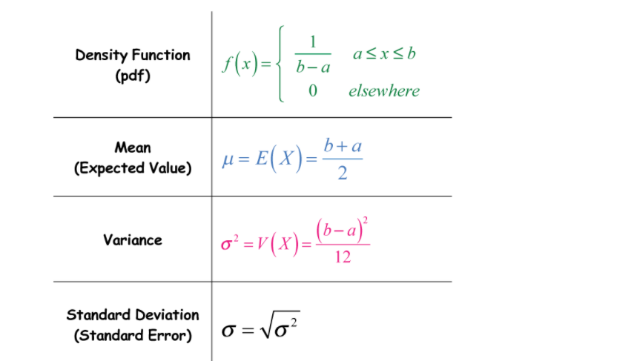

Slide 102
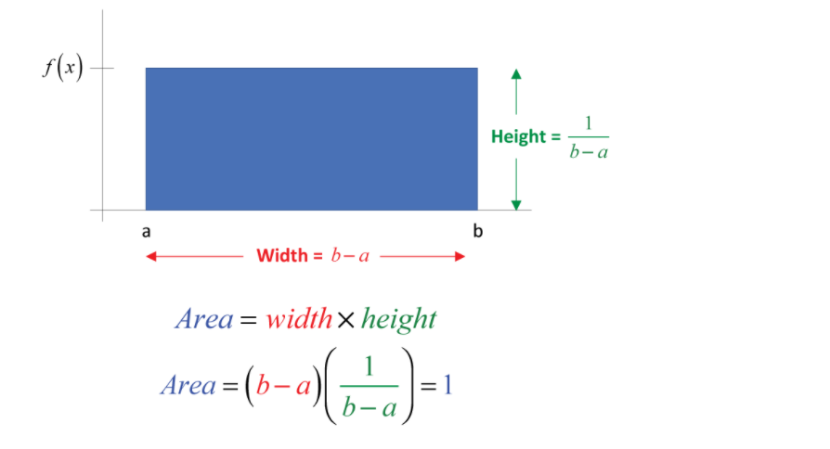

Slide 103
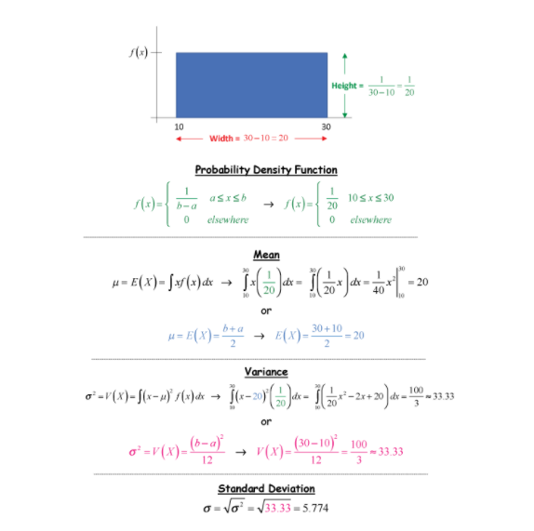

Slide 104
b = 50 a = 20

Slide 105
Cumulative Frequency
Cumulative frequency is defined as a running total of frequencies. The frequency of an element in a set refers to how many of that element there are in the set. Cumulative frequency can also defined as the sum of all previous frequencies up to the current point.

Slide 106
Age (years) | Frequency
10 | 3
11 | 18
12 | 13
13 | 12
14 | 7
15 | 27

Slide 107
Age (years) | Frequency | Cumulative Frequency
10 | 3 | 3
11 | 18 | 3 + 18 = 21
12 | 13 | 21 + 13 = 34
13 | 12 | 34 + 12 = 46
14 | 7 | 46 + 7 = 53
15 | 27 | 53 + 27 = 80

Slide 108
Age (years) | Frequency
40 | 3
51 | 18
62 | 13
93 | 4
76 | 7
15 | 27

Slide 109
Coefficient of Variation (CV)
The coefficient of variation (CV) is a statistical measure of the dispersion of data points in a data series around the mean. The coefficient of variation represents the ratio of the standard deviation to the mean, and it is a useful statistic for comparing the degree of variation from one data series to another, even if the means are drastically different from one another.

Slide 110
KEY TAKEAWAYS
The coefficient of variation (CV) is a statistical measure of the relative dispersion of data points in a data series around the mean.
In finance, the coefficient of variation allows investors to determine how much volatility, or risk, is assumed in comparison to the amount of return expected from investments.
The lower the ratio of the standard deviation to mean return, the better risk-return trade-off

Slide 111
Coefficient of Variation Formula
CV=σ/ μ
where:
σ=standard deviation
μ=mean​

Slide 112
Problem Statement:
From the following data. Identify the risky project, is more risky:
Year | 1 | 2 | 3 | 4 | 5
Project X (Cash profit in Rs. lakh) | 10 | 15 | 25 | 30 | 55
Project Y (Cash profit in Rs. lakh) | 5 | 20 | 40 | 40 | 30

Slide 113
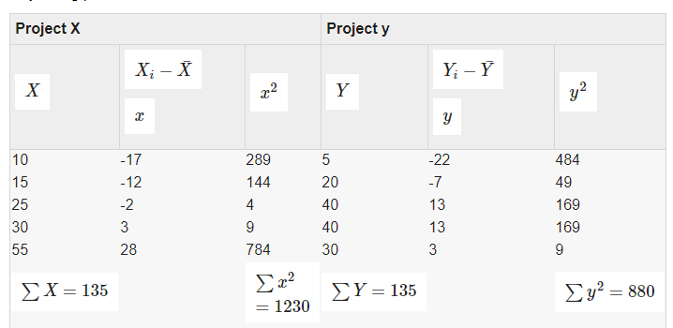

Slide 114
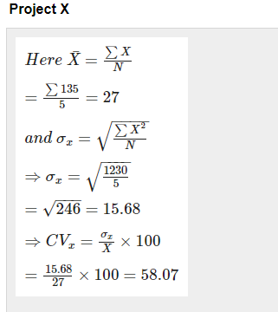
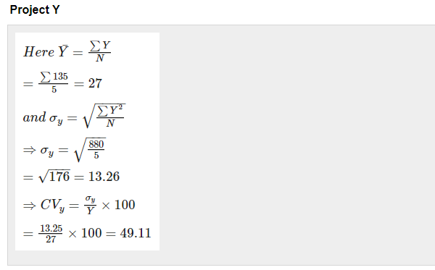

Slide 115
CV = Volatility / Expected return
CV = Volatility / Expected return x 100%

Slide 116
Stock investment?
To calculate the coefficient of variation in her potential stock investment, Jamila inputs her volatility percentage of 7 and her expected return percentage of 13.

Slide 117
Stock investment: CV = (7/13) x 100%
Divide the volatility and return first.
CV = .5385 x 100%
CV = .5385
Convert the answer into a percent by moving the decimal two places to the right.
CV = 53.9%

Slide 118
Bond investment?
To calculate the coefficient of variation in her potential stock investment, Jamila inputs her volatility percentage of 7 and her expected return percentage of 13.

Slide 119
Stock investment: CV = (7/13) x 100%
Divide the volatility and return first.
CV = .5385 x 100%
CV = .5385
Convert the answer into a percent by moving the decimal two places to the right.
CV = 53.9%

Slide 120
Bond investment?
calculate the coefficient of variation in her bond investment, Jamila inputs her volatility percentage of 6 and her expected return percentage of 4.

Slide 121
Bond investment: CV = (6/4) x 100%
Divide the volatility and return first.
CV = 1.5 x 100%
CV = .015
Convert the answer into a percent.
CV = 15%

Slide 122
Correlation Co-efficient
A correlation coefficient is a statistical measure of the degree to which changes to the value of one variable predict change to the value of another. In positively correlated variables, the value increases or decreases in tandem. In negatively correlated variables, the value of one increases as the value of the other decreases

Slide 123
The correlation coefficient formula is used in statistics mainly to analyze the strength of the relationship between the variables that are under consideration and further it also measures if there is any linear relationship between the given sets of data and how well they could be related.

Slide 124
Correlation coefficients are expressed as values between +1 and -1.
A coefficient of +1 indicates a perfect positive correlation: A change in the value of one variable will predict a change in the same direction in the second variable.
A coefficient of -1 indicates a perfect negative: A change in the value of one variable predicts a change in the opposite direction in the second variable. Lesser degrees of correlation are expressed as non-zero decimals. A coefficient of zero indicates there is no discernable relationship between fluctuations of the variables.

Slide 125
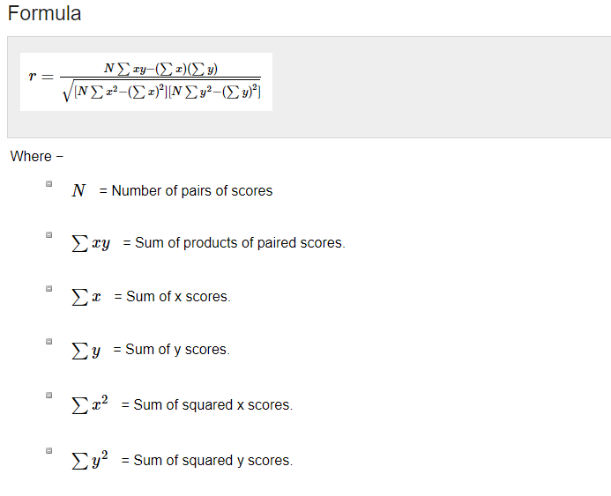

Slide 126
Calculate the correlation co-efficient of the following:
X | Y
1 | 2
3 | 5
4 | 5
4 | 8

Slide 127
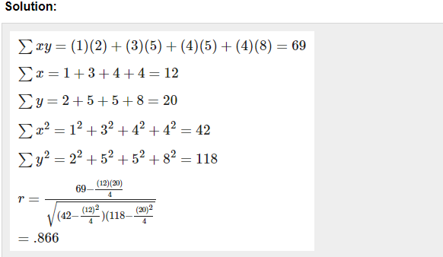

Slide 128
Pearson Correlation Coefficient
In statistics, the Pearson correlation coefficient also referred to as Pearson’s r or the bivariate correlation is a statistic that measures the linear correlation between two variables X and Y. It has a value between +1 and −1. A value of +1 is a total positive linear correlation, 0 is no linear correlation, and −1 is a total negative linear correlation.

Slide 129
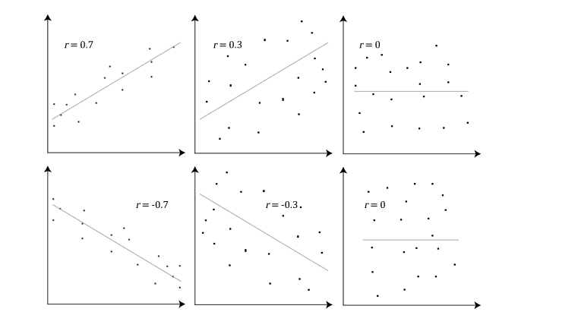

Slide 130
Spearman Correlation Coefficient
In statistics, Spearman’s rank correlation coefficient or Spearman’s ρ, named after Charles Spearman is a nonparametric measure of rank correlation (statistical dependence between the rankings of two variables). It assesses how well the relationship between two variables can be described using a monotonic function.

Slide 131
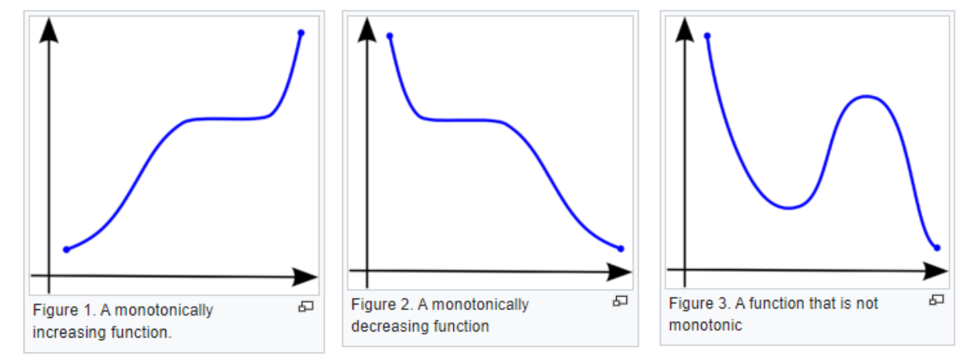

Slide 133
Cumulative Poisson Distribution
λ is the shape parameter which indicates the average number of events in the given time interval.
The following is the plot of the Poisson probability density function for four values of λ

Slide 134
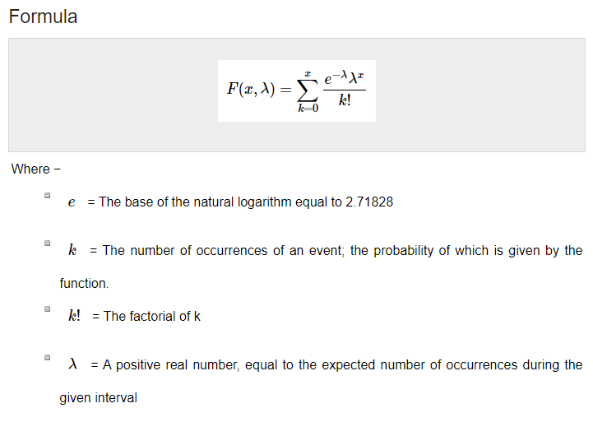

Slide 135
Problem Statement:
A complex software system averages 7 errors per 5,000 lines of code. What is the probability of exactly 2 errors in 5,000 lines of randomly selected lines of code?

Slide 136
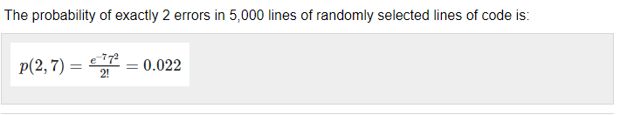

Slide 137
A park have 10 trees in one km. What is the probability of exactly 5 trees in one km?

Slide 138
Data Patterns
Data patterns are very useful when they are drawn graphically. Data patterns commonly described in terms of features like center, spread, shape, and other unusual properties. Other special descriptive labels are symmetric, bell-shaped, skewed, etc.

Slide 139
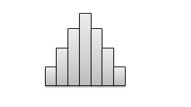
Center
The center of a distribution, graphically, is located at the median of the distribution. Such a graphic chart displays that almost half of the observations are on either side. Height of each column indicates the frequency of observations.

Slide 140
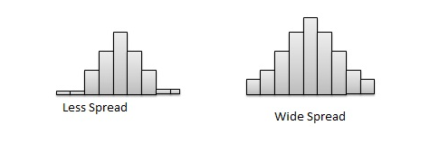
Spread
The spread of a distribution refers to the variation of the data. If the set of observation covers a wide range, the spread is larger. If the observations are centered around a single value, then the spread is smaller.

Slide 141
Shape
Symmetry - In symmetric distribution, graph can be divided at the center in such a way that each half is a mirror image of the other.
Number of peaks. - Distributions with one or multiple peaks. Distribution with one clear peak is known as unimodal, and distribution with two clear peaks is called bimodal. A single peak symmetric distribution at the center, is referred to as bell-shaped.
Skewness - Some distributions may have multiple observations on one side of the graph than the other side. Distributions having fewer observations towards lower values are said to be skewed right; and distributions with fewer observations towards lower values are said to be skewed left.
Uniform - When the set of observations has no peak and have data equally spread across the range of the distribution, then the distribution is called a uniform distribution.

Slide 142
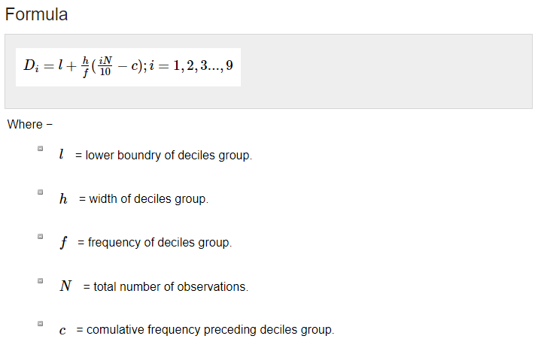
Deciles Statistics
A system of dividing the given random distribution of the data or values in a series into ten groups of similar frequency is known as deciles. In statistics, deciles are numbers that split a dataset into ten groups of equal frequency.
The first decile is the point where 10% of all data values lie below it. The second decile is the point where 20% of all data values lie below it, and so on.

Slide 143
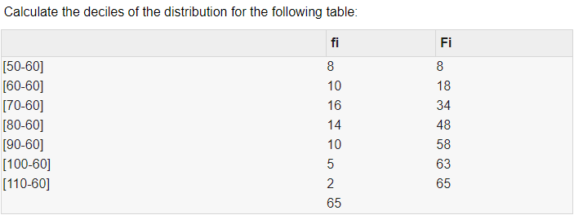

Slide 144
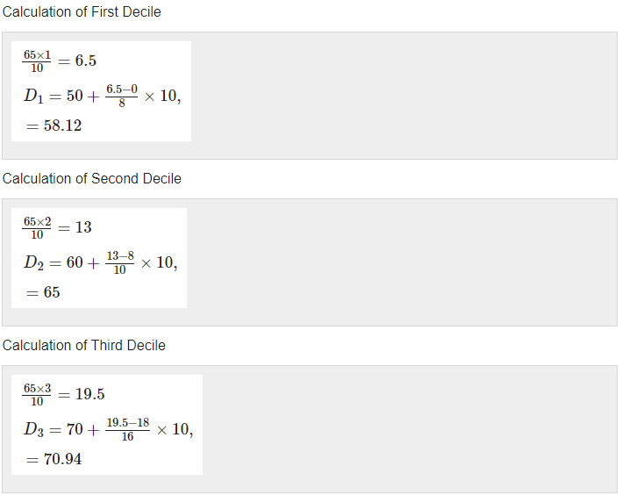

Slide 145
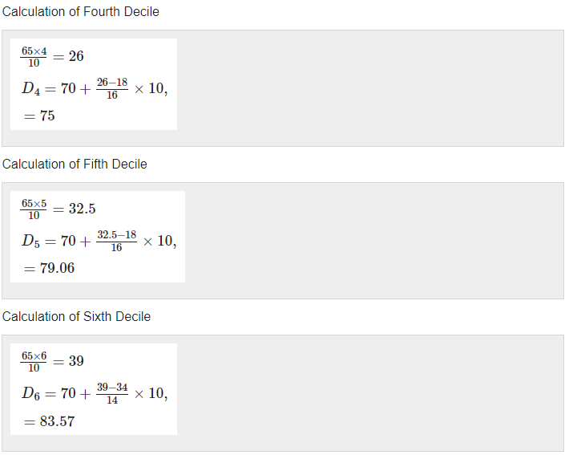

Slide 146
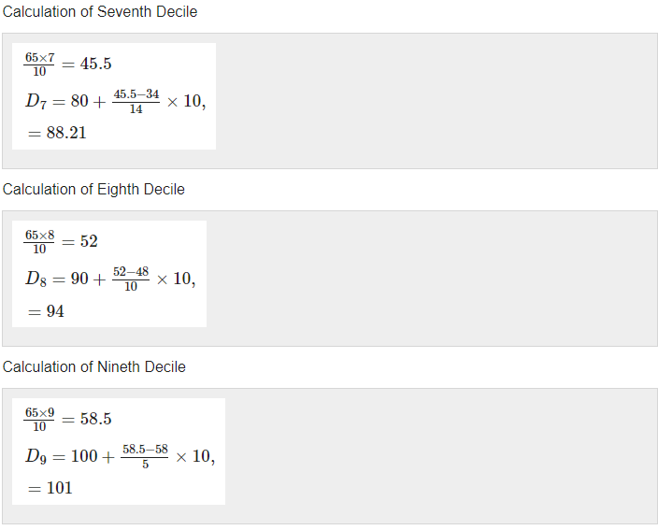

Slide 147
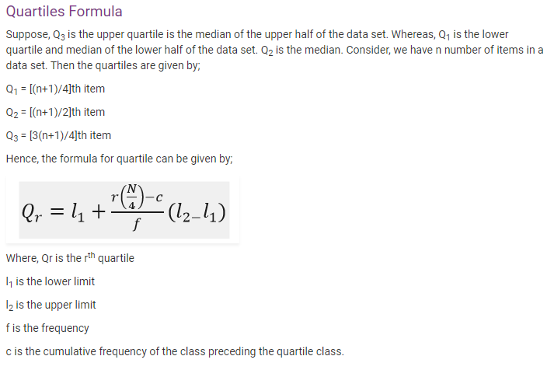

Slide 148
Similar to the median which divides the data into half so that 50% of the estimation lies below the median and 50% lies above it, the quartile splits the data into quarters so that 25% of the estimation are less than the lower quartile, 50% of estimation are less than the mean, and 75% of estimation are less than the upper quartile. Usually, the data is ordered from smallest to largest:
First quartile: 25% from smallest to largest of numbers
Second quartile: between 25.1% and 50% (till median)
Third quartile: 51% to 75% (above the median)
Fourth quartile: 25% of largest numbers

Slide 149
Question 1: Find the quartiles of the following data: 4, 6, 7, 8, 10, 23, 34.
23, 13, 37, 16, 26, 35, 26, 35

Slide 150
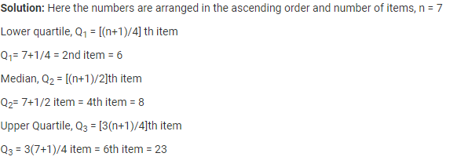
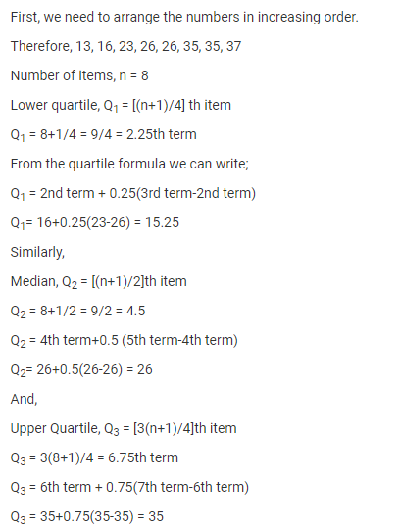

Slide 151
Diff between anova and chi-square
chi square is used when we have two categorical variables (e.g., gender and alive/dead) and want to determine if one variable is related to another. In ANOVA, we have two or more group means (averages) that we want to compare. In an ANOVA, one variable must be categorical and the other must be continuous. For example, we may want to examine if marijuana use (0 to 25 times) differs by grade level (9th grade, 10th grade, 11th grade).

